Slide 1

designing for the Alternative Energy market
CONFIDENTIAL: All contents copyright of Illinois Tool Works, Inc. (ITW).
The ITW Photonics Group, Cal Sensors, ITW Linx, Lumex and Opto Diode logos are registered trademarks of ITW, Inc. Copyright © 2012, all rights reserved.

Slide 2

Technology Trends for Alternative Energy Applications
Energy conservation is not just a fad, it’s the future. Efforts to reduce pollutants and greenhouse gases, as well as protecting our natural resources, are a primary focus in today's culture.
Because of the their many benefits, the use of optoelectronics have become intricate in paving the way for alternative energy applications.
Lumex’s customers are the global leaders and technology innovators in this particular market segment. Lumex’s wide range of products are being incorporated into novel applications every day in this exciting new market, such as:
    UV LEDs used for sterilization, filtration systems
    and gas detection
    LED and LCD technologies used in alternative
    energy processes such as wind, solar and
    geothermal
    Utilizing specific LED wavelengths for detection
    in agricultural and plastics sorting processes
    Extreme temperature LEDs and LCDs in the
    oil and gas industry for flow-line monitoring of
    pipelines and distribution networks
    High powered LEDs for monitoring underwater
    structures and marine biology
Design Considerations for Alternative Energy Applications
Extreme Temperatures
Long Life Span
Low Power Consumption
Wavelength Sensitivity
High Bright Visibility
Portability
Durability
CONFIDENTIAL: All contents copyright of Illinois Tool Works, Inc. (ITW).
The ITW Photonics Group, Cal Sensors, ITW Linx, Lumex and Opto Diode logos are registered trademarks of ITW, Inc. Copyright © 2013, all rights reserved.

Slide 3
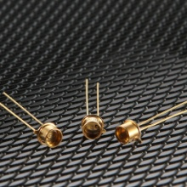
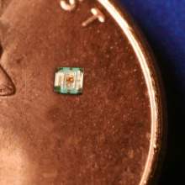
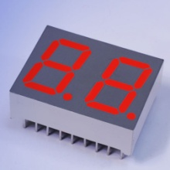
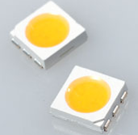
Product Components Ideal for the Alternative Energy Market
Ultraviolet (UV) LEDs
Available in 355nm, 365nm, 377nm, 385nm 405nm and 415nm wavelengths with 4-6mW power output
Longer lifespan; greater than 50,000 hours
TO-46 package, with glass lens in a through-hole format
Custom wavelengths are available
Lumex Product Families
High Power LEDs
Ultraviolet LEDs
Thru-Hole & SMD LEDs
Panel & PCB Indicators
LED Displays
LED Arrays
Light Pipes
Infrared Devices
Monochromatic & Color LCDs
0404 Surface-Mount RGB LEDs
Full color surface-mount RGB LED
0404 Packaging – 1.0mm x 1.00mm x 0.25mm
Low current operation (30/40/20 mcd respectively for RGB @ 2mA)
Operating temperature range from -40˚C to +85˚C
SMD & Thru-Hole High Temp LED Displays
Market-leading, operating temperatures up to 105˚C
Single & dual digit layouts available in standard stock
Triple or quad digit layouts available with no additional tooling
PLCC-6, 5050 Package
State-of-the-art high brightness chip technology
3 Dice per LED package
Lead frame / lens casting reliability
CONFIDENTIAL: All contents copyright of Illinois Tool Works, Inc. (ITW).
The ITW Photonics Group, Cal Sensors, ITW Linx, Lumex and Opto Diode logos are registered trademarks of ITW, Inc. Copyright © 2012, all rights reserved.
CONFIDENTIAL: All contents copyright of Illinois Tool Works, Inc. (ITW).
The ITW Photonics Group, Cal Sensors, ITW Linx, Lumex and Opto Diode logos are registered trademarks of ITW, Inc. Copyright © 2013, all rights reserved.

Slide 4
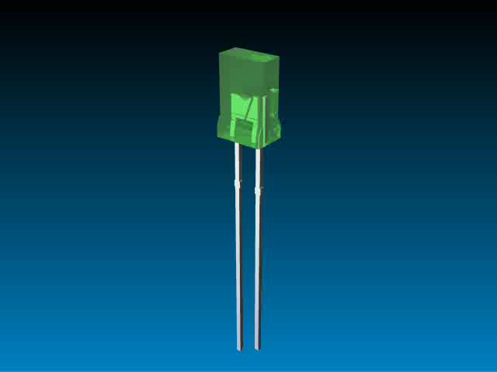
Multiple Technologies…
One Product Solution
In today’s competitive marketplace, many engineers are finding that many standard technologies do not meet all of their needs.
More and more, design engineers are recognizing that an application-specific solution will offer the best result for more complex design needs.
Lumex has proven success at translating initial design concepts and turning them into reality.
Whether addressing a current
design challenge or integrating
multiple components into one
sub-assembly, Lumex will work
with you from initial prototype
through final production.
Lumex offers experience,
quality and innovative originality
to help bring products to market
faster and help provide that
competitive edge.
Benefits of
Value Add Solutions
Focus on application needs
Stand out from competition
Enhanced reliability
Speed time to market
Reduced labor costs
Faster ROI
Full plug ‘n play solution
Engineering know-how that acts as an extension of your own team
CONFIDENTIAL: All contents copyright of Illinois Tool Works, Inc. (ITW).
The ITW Photonics Group, Cal Sensors, ITW Linx, Lumex and Opto Diode logos are registered trademarks of ITW, Inc. Copyright © 2013, all rights reserved.

